Slide 1
332:479 Concepts in VLSI
Design
Lecture 22
IEEE Boundary Scan Standard & System Test
M.L. Bushnell and V. D. Agrawal, Essentials of Electronic Testing for Digital, Memory and Mixed-Signal VLSI Circuits, Boston: Kluwer Academic Publishers, 2000

Slide 2
Outline
Boundary Scan Standard
  Purpose
  Pin electronics
  Instructions
System test
  Methods
  System-on-a-Chip (SoC) testing
Summary

Slide 3
IEEE 1149.1
Boundary Scan Standard

Slide 4
Motivation for Standard
Bed-of-nails printed circuit board tester gone
  We put components on both sides of PCB & replaced DIPs with flat packs to reduce inductance
    Nails would hit components
  Reduced spacing between PCB wires
    Nails would short the wires
  PCB Tester must be replaced with built-in test delivery system -- JTAG does that
  Need standard System Test Port and Bus
  Integrate components from different vendors
    Test bus identical for various components
    One chip has test hardware for other chips

Slide 5
Purpose of Standard
Lets test instructions and test data be serially fed into a component-under-test (CUT)
  Allows reading out of test results
  Allows RUNBIST command as an instruction
    Too many shifts to shift in external tests
JTAG can operate at chip, PCB, & system levels
Allows control of tri-state signals during testing
Lets other chips collect responses from CUT
Lets system interconnect be tested separately from components
Lets components be tested separately from wires

Slide 6
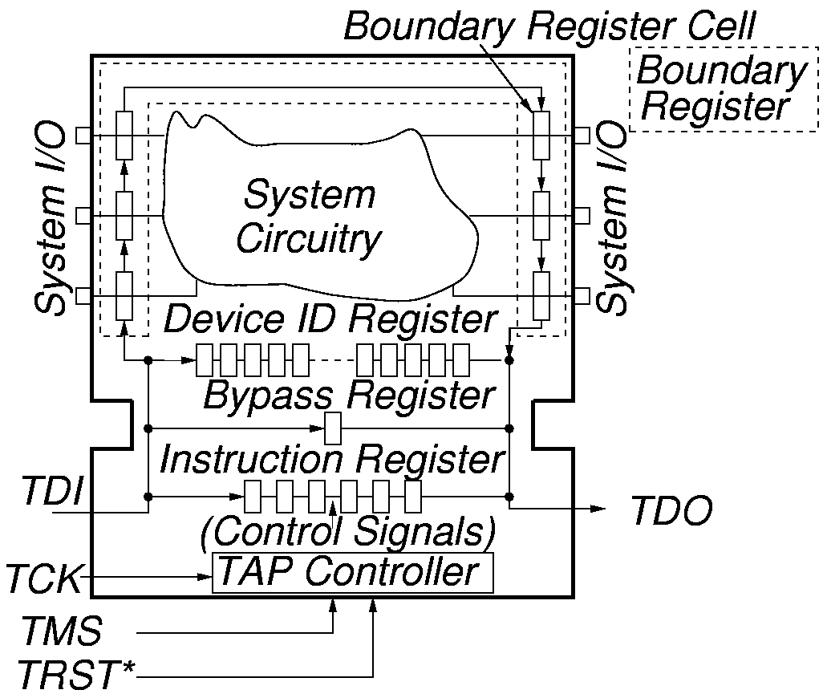
System Test Logic

Slide 7
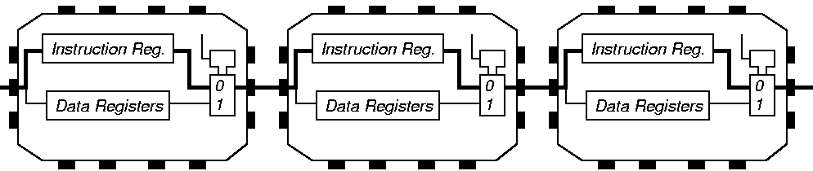
Instruction Register Loading with JTAG

Slide 8
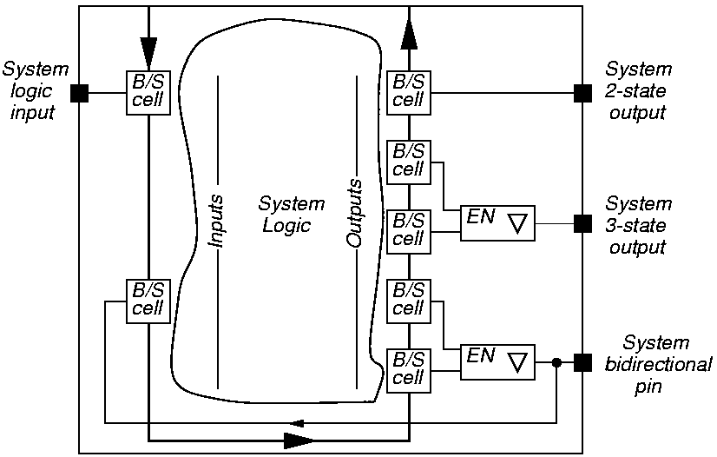
System View of Interconnect

Slide 9
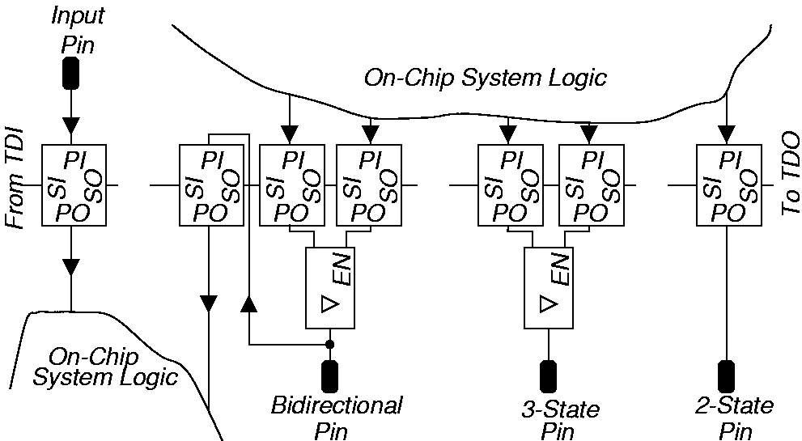
Boundary Scan Chain View

Slide 10
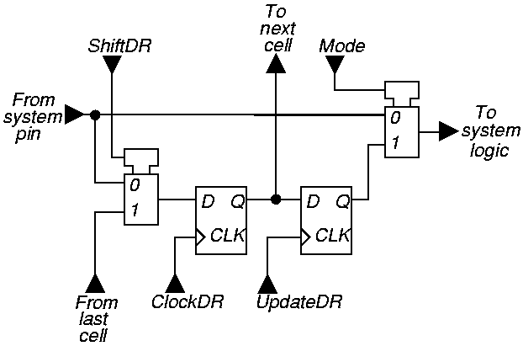
Elementary Boundary Scan Cell

Slide 11
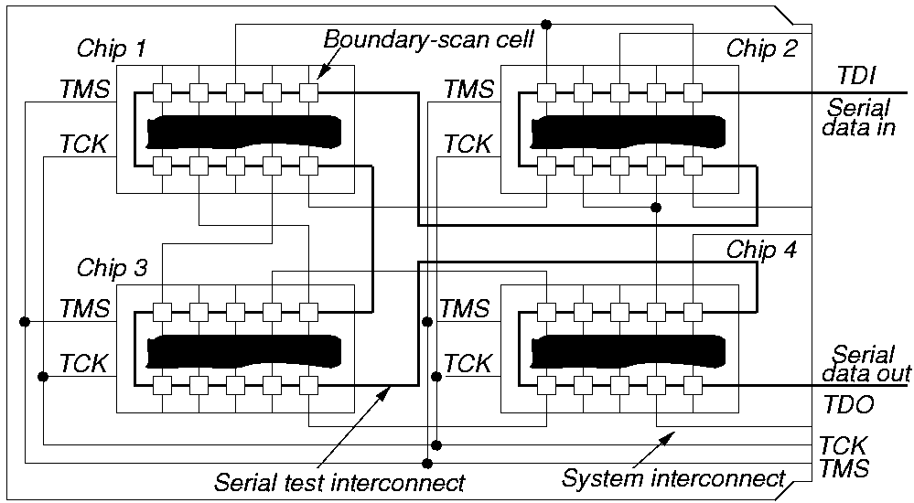
Serial Board / MCM Scan

Slide 12
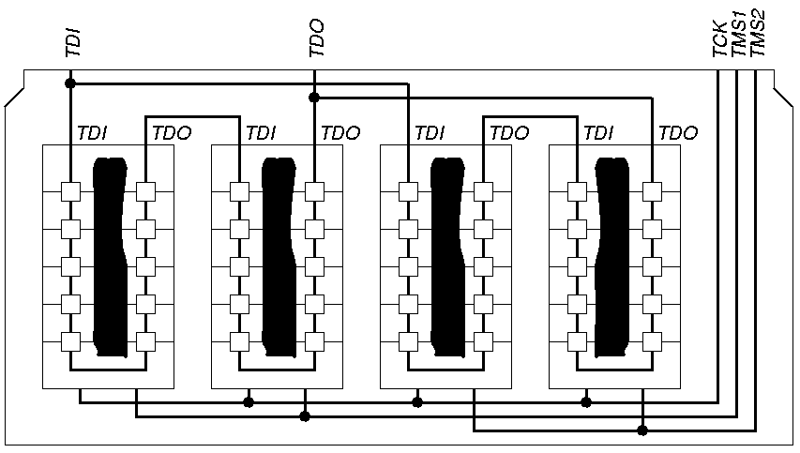
Parallel Board / MCM Scan

Slide 13
Tap Controller Signals
Test Access Port (TAP) includes these signals:
  Test Clock Input (TCK) -- Clock for test logic
    Can run at different rate from system clock
  Test Mode Select (TMS) -- Switches system from functional to test mode
  Test Data Input (TDI) -- Accepts serial test data and instructions -- used to shift in vectors or one of many test instructions
  Test Data Output (TDO) -- Serially shifts out test results captured in boundary scan chain (or device ID or other internal registers)
  Test Reset (TRST) -- Optional asynchronous TAP controller reset

Slide 14
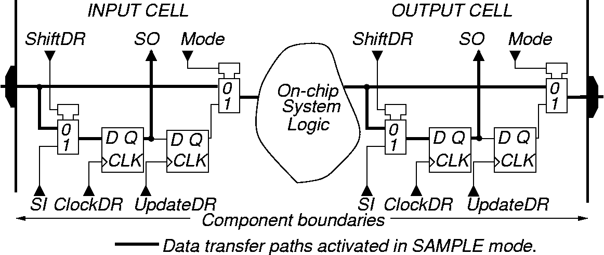
SAMPLE / PRELOAD Instruction -- SAMPLE
Purpose:
Get snapshot of normal chip output signals
Put data on bound. scan chain before next instr.

Slide 15
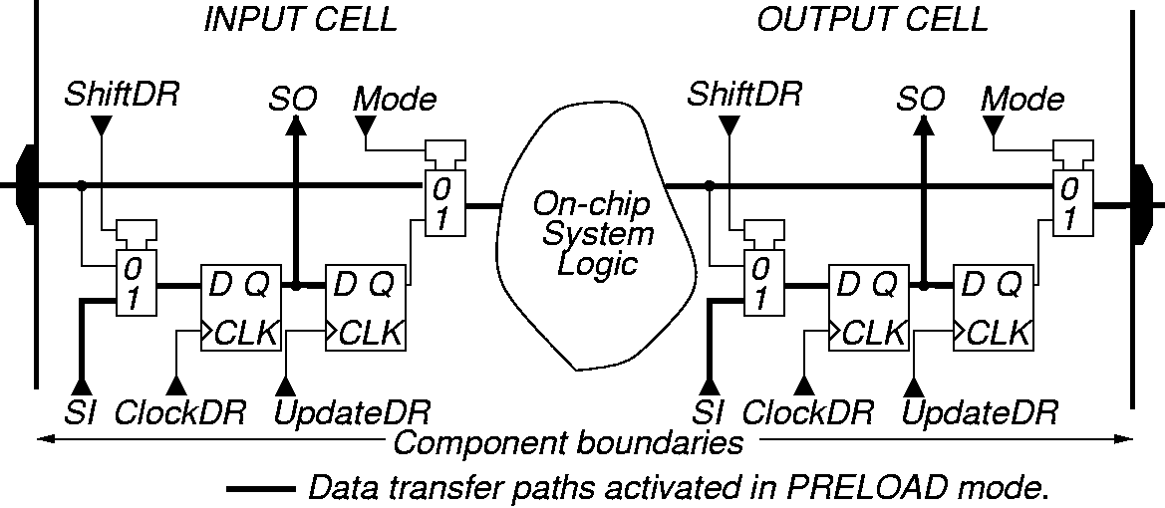
SAMPLE / PRELOAD Instruction -- PRELOAD

Slide 16
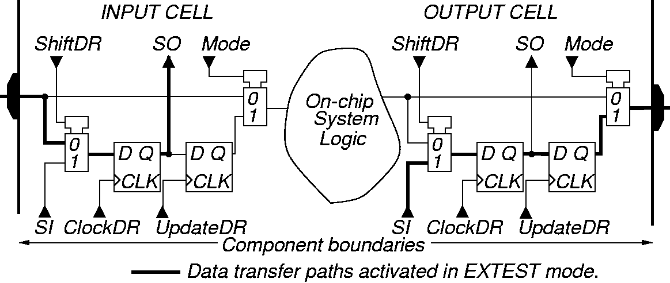
EXTEST Instruction
Purpose: Test off-chip circuits and board-level interconnections

Slide 17
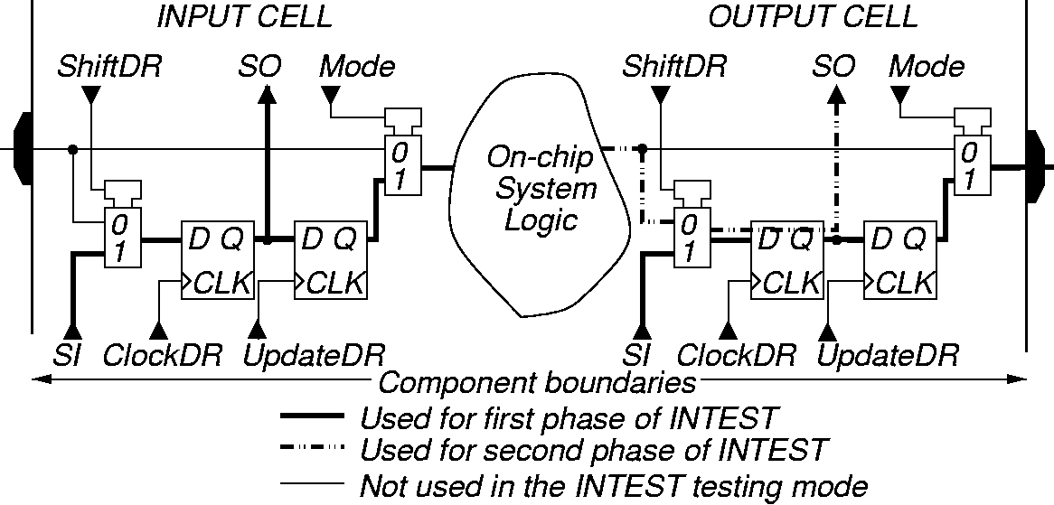
INTEST Instruction
Purpose:
  Shifts external test patterns onto component
  External tester shifts component responses out

Slide 18
RUNBIST Instruction
Purpose: Allows you to issue BIST command to component through JTAG hardware
Optional instruction
Lets test logic control state of output pins
  Can be determined by pin boundary scan cell
  Can be forced into high impedance state
BIST result (success or failure) can be left in boundary scan cell or internal cell
  Shift out through boundary scan chain
May leave chip pins in an indeterminate state (reset required before normal operation resumes)

Slide 19
Summary
Boundary Scan Standard has become absolutely essential --
  No longer possible to test printed circuit boards with bed-of-nails tester
  Not possible to test multi-chip modules at all without it
  Supports BIST, external testing with Automatic Test Equipment, and boundary scan chain reconfiguration as BIST pattern generator and response compacter
  Now getting widespread usage

Slide 20
System Test

Slide 21
A System and Its Testing
A system is an organization of components (hardware/software parts and subsystems) with capability to perform useful functions.
Functional test verifies integrity of system:
    Checks for presence and sanity of subsystems
    Checks for system specifications
    Executes selected (critical) functions
Diagnostic test isolates faulty part:
    For field maintenance isolates lowest replaceable unit (LRU), e.g., a board, disc drive, or I/O subsystem
    For shop repair isolates shop replaceable unit (SRU), e.g., a faulty chip on a board
    Diagnostic resolution is the number of suspected faulty units identified by test; fewer suspects mean higher resolution

Slide 22
System Test: Partitioning for Test
Partition according to test methodology:
  Logic, Memory, and Analog blocks
Provide test access:
  Boundary scan
  Analog test bus
Provide test-wrappers (also called collars) for cores
  Core is a chip layout part
  System-on-a-chip made up of multiple cores

Slide 23
Test-Wrapper for a Core
Test-wrapper (or collar) is the logic added around a core to provide test access to the embedded core.
Test-wrapper provides:
  For each core input terminal
    A normal mode – Core terminal driven by host chip
    An external test mode – Wrapper element observes core input terminal for interconnect test
    An internal test mode – Wrapper element controls state of core input terminal for testing the logic inside core
  For each core output terminal
    A normal mode – Host chip driven by core terminal
    An external test mode – Host chip is driven by wrapper element for interconnect test
    An internal test mode – Wrapper element observes core outputs for core test

Slide 24
A Test-Wrapper
Wrapper
elements
Core
Functional
core inputs
Functional
core outputs
Scan chain
Scan chain
from/to
External
Test pins
Scan chain
Wrapper
test
controller
to/from TAP

Slide 25
DFT Architecture for SOC
Test
source
User defined test access mechanism (TAM)
Test
sink
Func.
outputs
Functional
outputs
Functional
inputs
Func.
inputs
Module
1
Module
N
Test
wrapper
Test
wrapper
Instruction register control
Test access port (TAP)
Serial instruction data
SOC inputs
TDI
TCK
TMS
TRST
TDO
SOC outputs

Slide 26
Summary
Functional test: verify system hardware, software, function and performance; pass/fail test with limited diagnosis; high (~100%) software coverage metrics; low (~70%) structural fault coverage.
Diagnostic test: High structural coverage; high diagnostic resolution; procedures use fault dictionary or diagnostic tree.
SOC design for testability:
    Partition SOC into blocks of logic, memory and analog circuitry, often on architectural boundaries.
    Provide external or built-in tests for blocks.
    Provide test access via boundary scan and/or analog test bus.
    Develop interconnect tests and system functional tests.
    Develop diagnostic procedures.

Slide 27
References
For a course on testing taught at Rutgers University, see website:
http://www.caip.rutgers.edu/~bushnell/rutgers.html

